Slide 1
Steganography Tool using Image Encryption & Decryption
CAPSTONE PROJECT
Presented By: Adwait Deshpande
Student Name : Adwait Deshpande
College Name & Department : Msc Digital Forensics and Information Security, NFSU, Goa

Slide 2
OUTLINE
Problem Statement
Technology used
Wow factor
End users
Result
Conclusion
Git-hub Link
Future scope

Slide 3
Problem Statement
With increasing digital communication, securing sensitive information is crucial. This project enables users to hide messages inside images securely and retrieve them using a password-protected mechanism.

Slide 4
Technology used
- Python (Tkinter, OpenCV)
- Image Processing
- Steganography Techniques
- Graphical User Interface (GUI)

Slide 5
Wow factors
- Password-Protected Encryption & Decryption
- Simple and User-Friendly GUI
- Works with Any Image File
- Prevents Unauthorized Access
- Hidden Message Cannot be Seen Normally

Slide 6
End users
- Individuals for Private Communication
- Cybersecurity Professionals
- Journalists & Activists (Secure Messaging)
- Educational Institutions (Learning Steganography)

Slide 7
Results
Users can successfully encrypt and decrypt hidden messages inside images securely using a simple GUI with password protection.

Slide 8

Results

Slide 9

Results

Slide 10
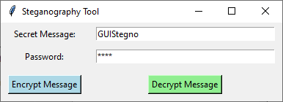
Results

Slide 11
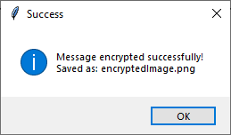
Results

Slide 12
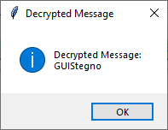
Results

Slide 13
Conclusion
This project provides a secure and efficient way to hide and retrieve sensitive information within images. It enhances privacy and ensures data remains protected from unauthorized access.

Slide 14
GitHub Link
https://github.com/adwaitdeshpande-and/stenography.git

Slide 15
Future scope(optional)
- Support for More Image Formats
- Improved Security with Advanced Encryption
- Mobile App Integration
- Cloud-Based Secure Image Storage

Slide 16
THANK YOU

